Slide 1
“Autoencoder with CIFAR-10”

Slide 2
introduction
Purpose: Autoencoders aim to compress input data into a lower-dimensional representation and then reconstruct it back to the original or a close approximation of the original.
Applications: Commonly used in image compression, noise reduction, anomaly detection, and feature extraction.

Slide 3
Key Components
Encoder:
Function: The encoder compresses the input data into a compact, lower-dimensional representation called the latent space or bottleneck.
Structure: Typically consists of several layers of neurons that reduce the input data size progressively.
Example: If the input is a 32x32 pixel image, the encoder might reduce this to a 16x16, 8x8, and eventually down to a 4x4 representation.
Latent Space (Bottleneck):
Function: Represents the compressed knowledge of the input data. It captures the most important features needed to reconstruct the original data.
Characteristics: The size of the latent space is usually much smaller than the original input size.

Slide 4
Key Components
Decoder:
Function: The decoder takes the compressed representation from the latent space and reconstructs it back to the original size.
Structure: Mirrors the encoder but in reverse, expanding the data back to its original dimensions.

Slide 5
How Autoencoders Work
Input Data: A piece of data, such as an image, is fed into the network.
Encoding: The encoder compresses this data into a smaller, abstract representation.
Latent Space: This abstract, compact representation holds the essential features of the input data.
Decoding: The decoder reconstructs the compressed data back into a form as close to the original input as possible.
Output Data: The output is the reconstructed data, which should ideally be very similar to the input.

Slide 6
Autoencoders
Pros
Cons
Dimensionality reduction
Data compression
Noise reduction
Anomaly detection
Unsupervised learning
Captures non-linear relationships
Data reconstruction quality
Training complexity
Overfitting risk
Limited feature interpretability
Data dependency
Hyperparameter sensitivity

Slide 7
CIFAR-10 Dataset
Content: 60,000 colour images of 32x32 pixels.
Size: 50,000 training images and 10,000 test images.
Classes: 10 categories (airplane, automobile, bird, cat, deer, dog, frog, horse, ship, truck).
Purpose: Used for training and evaluating image classification algorithms..
Availability: Publicly accessible and widely used in computer vision research.

Slide 8
Project goals
Objective:
To explore the capabilities of autoencoders for image compression and
feature extraction using the CIFAR-10 dataset.
Problem Statement:
Develop and train an autoencoder model that can effectively compress and
reconstruct images from the CIFAR-10 dataset while preserving important
visual features and minimizing reconstruction error.

Slide 9
Original encoder model
Epochs: Trained for 40 epochs.
Learning Rate: Adam optimizer with a learning rate
of 0.0002.
Loss Function: Used ’Mean_squared_error’
Pooling Layer: Used MaxPooling2D

Slide 10
Modified encoder model
Pooling Layer: Changed to AveragePooling2D.
Epochs: Reduced to 5 epochs for faster training.
Learning Rate: Adam optimizer with a learning rate
of 0.0002 (not changed).
Loss Function: Changed to 'binary_crossentropy'.

Slide 11
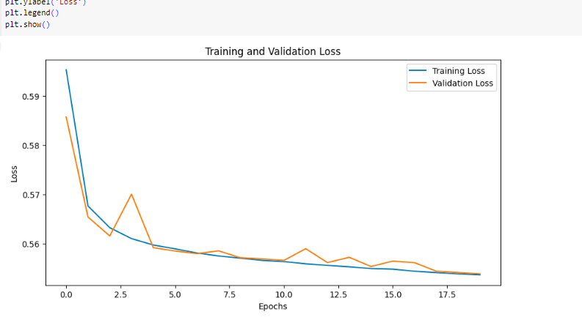
20 epochs

Slide 12
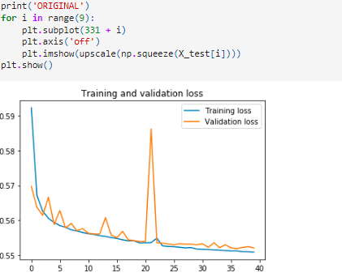
40 epochs

Slide 13
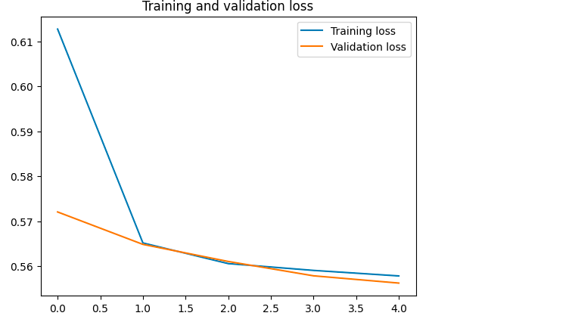
10,5 epochs

Slide 14
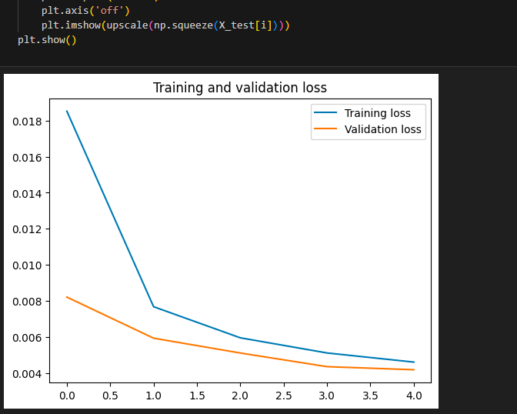
5,5 Epochs

